Slide 2
Travel details We will be leaving on Tuesday 31st March mid morning so usual arrival time at school please. We will return before the end of the school day on Wednesday 1st April.

Slide 3
Staff Mrs Biddulph Mrs Staton Miss Dinsdale Mrs Baldwin / Mrs Bridgett Mr Bridger – Brooks Mrs Price / Mrs Bradley Mr Cheetham Mrs Taylor HI support – to be confirmed

Slide 5
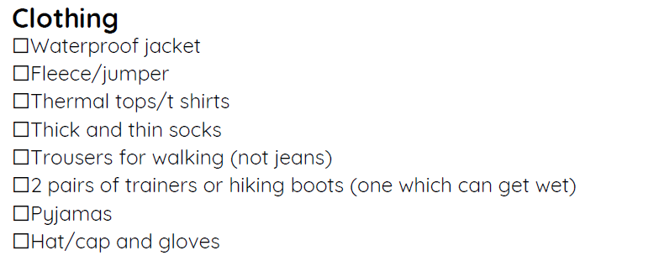
One overnight bag is sufficient to hold all your child needs to bring with them.

Slide 7
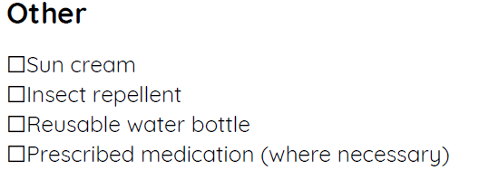

Slide 8
Mealtimes Children need to bring a packed lunch with them on the Tuesday. Please do not send lunchboxes. Snacks for ‘breaktime’

Slide 9
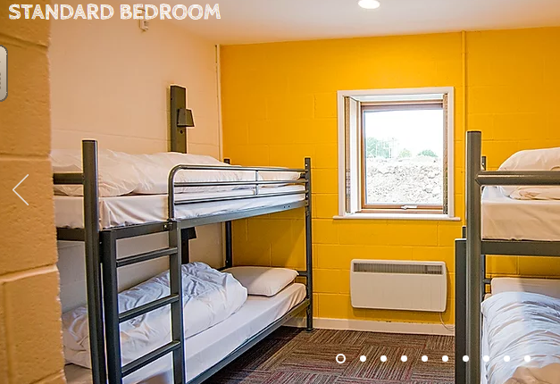
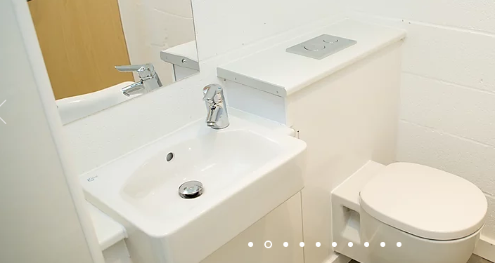
Accommodation

Slide 10
Activities Zip Wire Land Karts The Mount Cook Challenge Orienteering Offsite

Slide 11
Home comforts Children can bring a teddy. A book to read at night time would be a good idea. No electronics. No mobile phones. Home contact – The Willows Office will send update texts to advise of safe arrival, departure and updated return time.

Slide 12
Medical, Allergies and Dietary requirements Please inform your class teacher of any medical changes since you completed the medical form. Please ensure your class teacher is aware of any dietary requirements.

